Slide 1

ORACLE ERP Services

Slide 2
Agenda
SumPositive Offshore Overview
Devops Offering
Devops Strategy
Co-ordination Model
Ticketing System Options
Rate Card
Selected Staff

Slide 3




About SumPositive Offshore
Offshore offices in:
Hyderabad , India (1 Corporate Office , 2 Development Centers)
Offshore India Staff of 250 +
Multiple technology Implementation with focus on Oracle Technologies
24/7 (round the clock) active office hours

Slide 4



Hours of Operation
Hours of Operation
Europe Support Timings:
2. USA Support Timings
IST | GMT
11.30 AM 8.30 PM | 6.00 AM 3.00 PM
Note: We can provide extended hour support based
on Timex client requirement .We have staff in other regions that we would leverage for 24/7 coverage.
IST | EST | PST
5.30 PM 2.30 AM | 8.00 AM 5.00 PM | 5.00 AM 2.00 PM

Slide 5
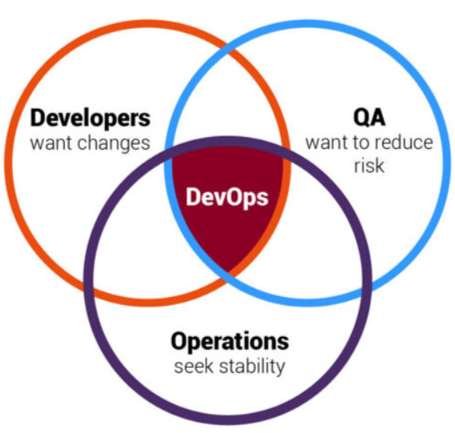
DevOps Offering
Support Services
Imlementation/Delivery Services
API :
Source and target test queries
Connections to data stores
Tests associated with an execution suite
New staging tables from various data connections
Custom flow controls based on run results
Automation
Tools selection
Continuous Integration
Continuous Infrastructure
Continuous deployment/delivery
Implementation
Execute DevOps flawlessly.
Find and fix errors in real-time
Agile Development
API data solution for continuous data testing.
DevOps process automation service.
DevOps Implementation Services.

Slide 6
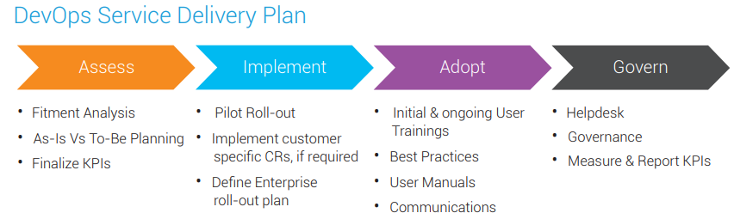
DevOps Offering
Service delivery
Imlementation/Delivery Services
Assessment
Implementation
Adopt
Governance
Progressive model-based test
Web applications
Desktop testing
Mobile applications (Andriod)

Slide 7
DevOps Goals and Objectives
Goals
Objectives
Establish a consistent and automated way to build, package, and deploy applications.
Quicken release cycles
Increase quality & reliability
Security compliance
Standardize CICD
Automate software delivery pipeline
Notification & Authorization in pipeline
Blue-Green / Canary deployment support in pipeline
Alignment to future state technology and architecture standards and re-use
Promote ease of adoption through detailed documentation/playbook

Slide 8
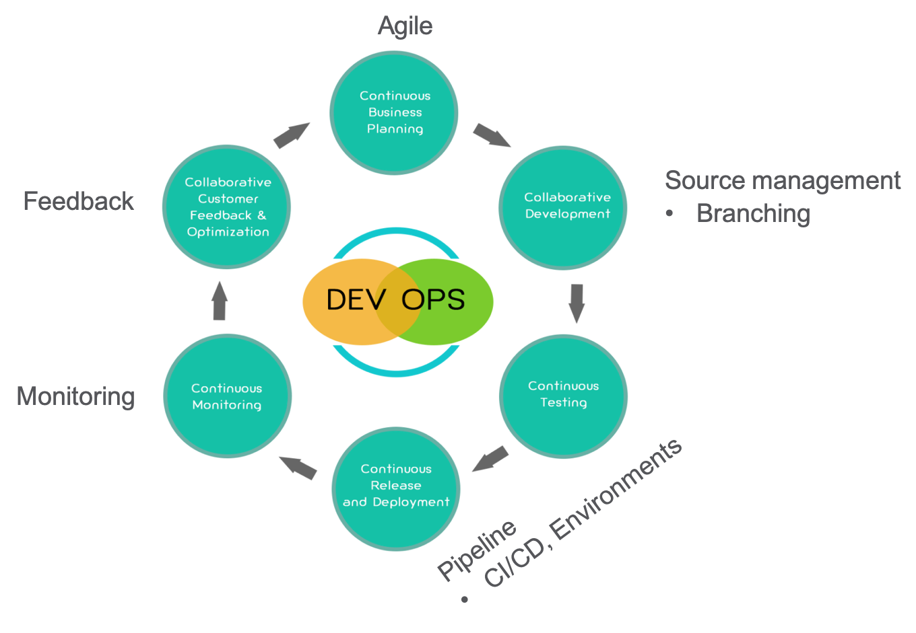
DevOps Strategy

Slide 9
DevOps Development Instances
TEST/DEV
Environment available for Developers to deploy and Test the work in progress
Low configuration environment with policies to control cost
STAGE/QA/UAT
Environment for Functional, Regression, End-to-End test
Low Configuration and cost considerations
PERFORMANCE
Environment for Endurance/Performance/Stress test
Automatic Spin Up and tear down approach
PRODUCTION
Environment for production available to users
Support for Blue/Green/Canary Deployment
Secured and monitored

Slide 10
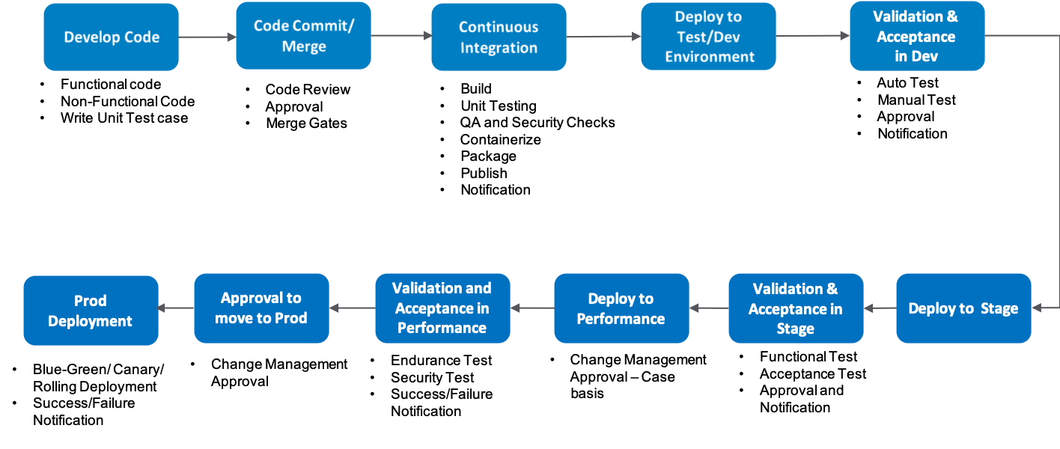
Deployment Flow

Slide 11




Oversight / Coordination Model
On behalf of
Ventiv Risk Services Pvt. Ltd
Client Partner
Business Team
Sum Positive
Technical Lead/Team
Sum Positive Project Lead
Project Lead
SP Program Manger
Program Manager
Client IT Applications Manager
We act as an extension of your team.
Provides service oversight, client advocacy & planning.
Client Business Analysts (Optional)

Slide 12







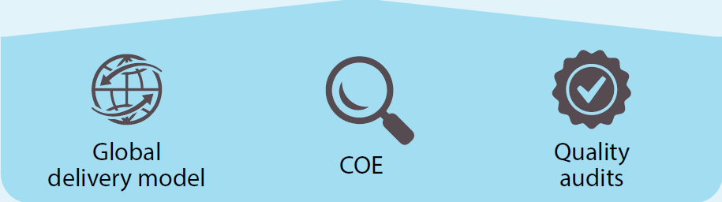
Ticketing Process – Client Managed
❶
❻
❽
Ticketing System
automatically sends updates
Client Email
Information Updated
Ticket Resolved
Client
❺
❷
Ticket Created
(Auto/Manual)
❸
❹
❼
SumPositive
Resource
Assigned
Resource
Communication
Issue
resolved

Slide 13
Ticketing Process – Client Managed
All our employees will have Sum Positive Email addresses.
Our employees will use our email address for all client/external communications related to Project.
Ventiv Risk Services Pvt. Ltd may employee an onsite Business Analyst and will work with our employees.
We will assign our Client Partner for Ventiv Risk Services Pvt. Ltd who will manage all logistical relationship.
We will use Sum Positive Email addresses to login to client managed ticketing systems such as:
Jira Cloud
Remedy On Demand
Manage Engine
Zoho Service Desk

Slide 14
Resources
We already have key resources immediately to get started .
Typical onboarding time for new resources is 3-4 weeks.

Slide 15

Selected Staff

Slide 16
DevOps Team
Program Manager : - Ravi kumar
Overall 18+ years of experience in developing and maintaining Enterprise applications with Agile
Ex- Oracle Project Manager with 15+ Years of overseas experience
Completed 4.7 million USD project with in a span of 1.4 years as Project Manager with high quality Delivery
Project Lead Cloud & DevOps–Rama Krishna
Technical consultant – Samantha Changal
Overall 10+ years of experience in developing and maintaining Enterprise applications with Agile
Managed End-to-End solution with Ansible for configuration management – IaaS, Expertise tools Jenkins, SCM, Artifactory, Python, Coordinator Kubernetes, Openshift, Google Anthos.
Frameworks like Spring Boot, Netflix OSS, Angular.
Industry Telecom, Health Care, Banking & Finance
Technical consultant with diverse operational experience in both IT Digital transformation and Engineering.
Over 15+ experience Design, build and configure applications to meet business process and application requirements in a large digital transformation program.
Development of IT Application core project management tools & integrating business applications and configuring Productivity tools.

Slide 17
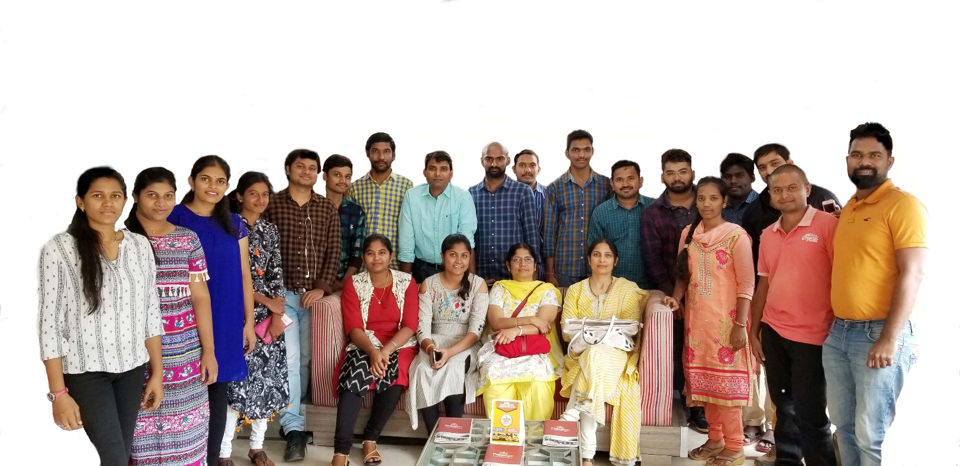
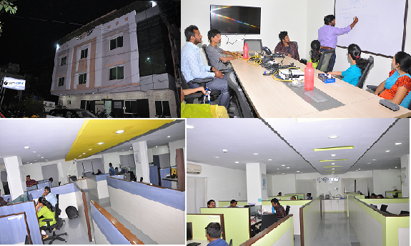
Thank you!

